Slide 1
Nuclear Fuel Performance
NE-533
Spring 2023

Slide 2
Housekeeping
Gone on Wed-Fri, will have a guest lecture via zoom on Thursday from Dr. Larry Aagesen (INL) – will be in class, also, your choice
MOOSE project part 1 due on Friday
submission is available on Moodle
closes 11:59 pm on Feb 24
This is the last lecture of the second module, topics up to Thursday’s lecture will be covered on the exam, which will be on March 2 (next Thursday)
Problem session next Tuesday, plus start module 3

Slide 3
Last Time
Gap size changes due to thermal expansion
Often have displacements instead of strains, and can solve for stress via displacements
All fuel performance codes must:
Numerically model the temperature in the fuel
Numerically model the stress in the cladding
And consider gap pressure, closure, and heat transfer in some way
Identified and talked through the primary US fuel performance codes

Slide 4
Material Property Evolution

Slide 5
Pretty much everything we have learned so far, nothing changes once the fuel and cladding reach steady state

Slide 6
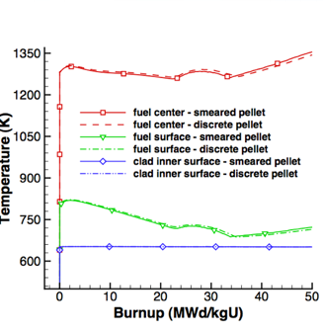
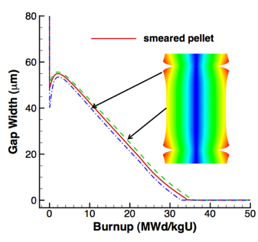
Fuel is dynamic!

Slide 7
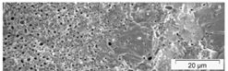
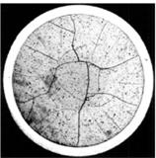
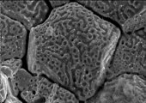


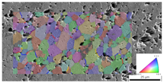
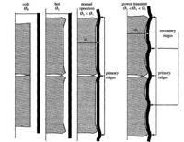
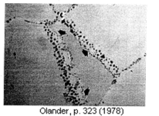
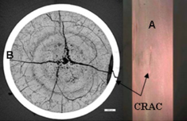
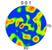
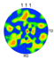
Property changes due to microstructure evolution during reactor operation must be considered
Insertion in reactor
Removal from reactor
Early life
Thermal expansion
Fracture
Point defect and fission gas generation
Fuel Densification
Mid Life
Point defect diffusion
Point defect clustering
Fission gas segregation to GB and voids
Bubble nucleation
Late life
Fission product swelling
Bubble percolation and fission gas release
Cladding creep
Fuel creep
Fuel failure
Pellet/cladding interaction
Cladding corrosion
Cladding fracture
Fuel Fabrication
Sintered UO²
Height 2 cm
Diameter 1 cm
~10 μm grain size
Density > 95%
Brohan 2000
From Pedro Peralta, ASU
Zinkle and Singh 2000
Santana et al. 2011

Slide 8
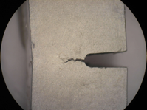
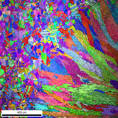
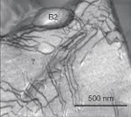
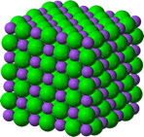
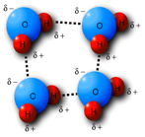
The properties and performance of a material are a result of factors across various length scales
Material properties and performance
Microstructure
Defect interactions
Crystal structure
Chemical bonds

Slide 9
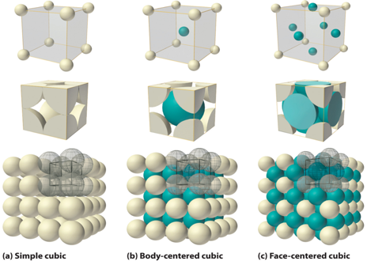
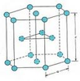
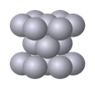
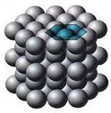
The crystal structure of a material is the shape of the ordered structure of the atoms
The atoms of many materials form an organized lattice, these are called crystalline materials. All reactor materials are crystalline.
The configuration of the atoms in the lattice impacts the properties of the material (density, thermal expansion coefficient, elastic modulus, etc.)
All major light water nuclear materials are either cubic or hexagonal
(d) Hexagonal close packed

Slide 10
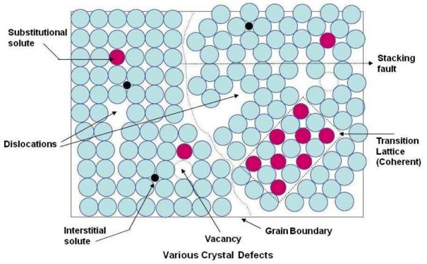
Crystalline materials
In crystalline materials, the lattices are not perfect, they have defects
Defects can be 0D, 1D, 2D, 3D
The interactions between defects seriously impact material properties and how they perform

Slide 11
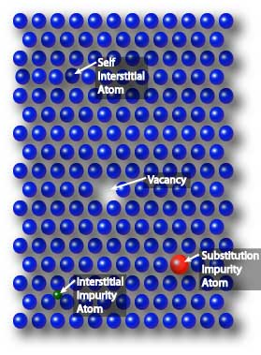
Point defects
Point defects (zero-dimensional defects) are lattice imperfections related to one or two lattice sites
There are several types of point defects
Vacancies
Self interstitial atoms (SIA)
Interstitial impurity atoms
Substitutional impurity atoms
Point defects control the mobility of atoms and, therefore influence all processes that depend on diffusion

Slide 12
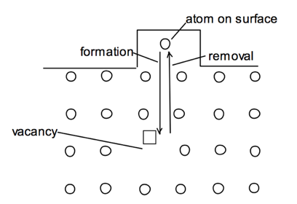
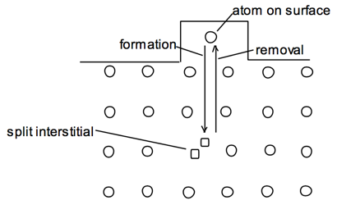
Point defects
Vacancies and interstitials form naturally in materials
Extra atoms can sit on a surface, creating a vacancy, or a surface can have a missing atom, creating a self interstitial atom (SIA)
We define the number of vacancies or interstitials in terms of a concentration
There exists an equilibrium concentration of point defects

Slide 13
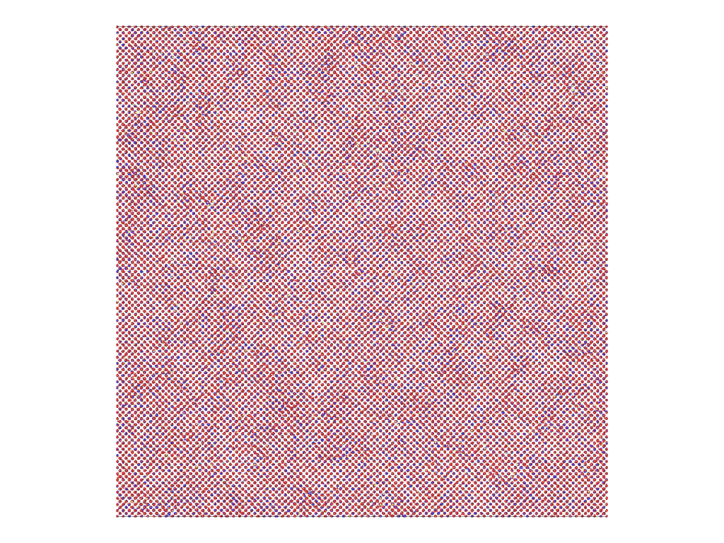
Radiation damage
Ionizing radiation can introduce defects into the crystal lattice, called radiation damage
PKA collisions create a collision cascade, which results in the generation of defects (point and clusters)

Slide 14
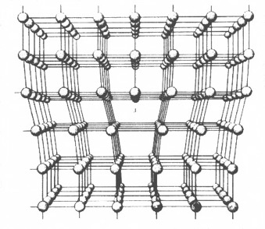
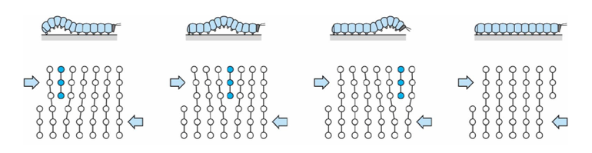
Dislocations are imperfections associated with a line of lattice sites (1D defect)
In a dislocation, an extra half plane of atoms is inserted into the lattice
When it moves, only a small number of bonds are broken at a time
Dislocation motion controls the plastic (permanent) deformation of crystalline materials

Slide 15
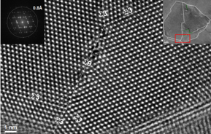
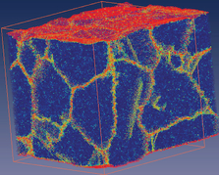
Grain boundaries
Materials are typically composed of various regions where the crystal lattice is oriented differently. These regions are called grains
When two grains meet, there is a plane of atoms that do not follow the crystal lattice called a grain boundary
Most crystalline materials are polycrystalline, not single crystal
High-res transmission eleectron microscopy can also show individual atoms (palladium)
www.knmf.kit.edu/TEM.php
Atomistic simulation of grain boundaries in 3D

Slide 16
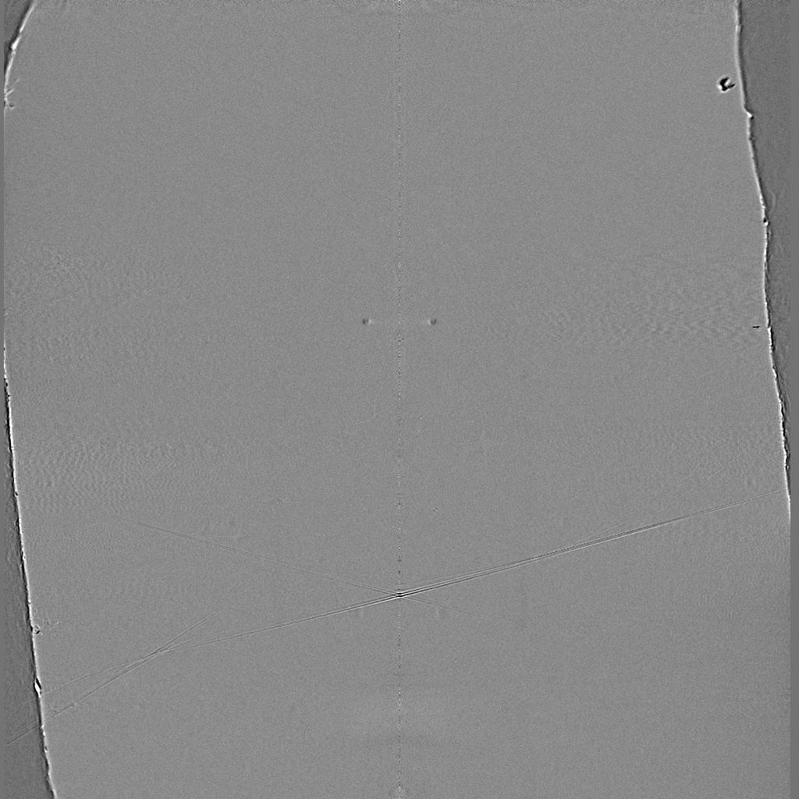
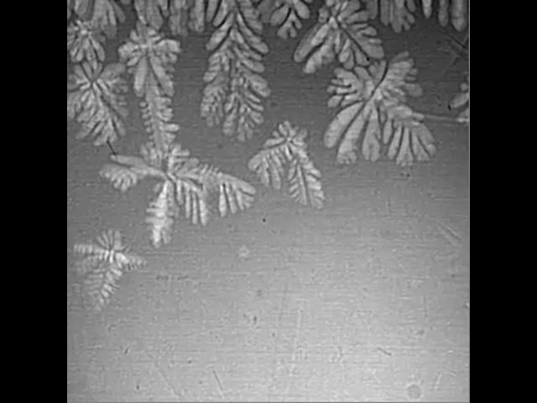
Metals are often cast, and polycrystals naturally form during casting

Slide 17
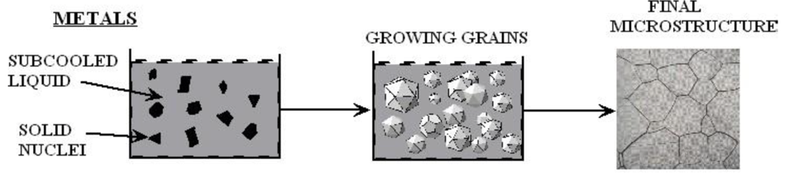
Polycrystals naturally form during casting
Solidification begins in different regions of the melt, each with a different orientation
Once the different regions meet, grain boundaries form between them

Slide 18
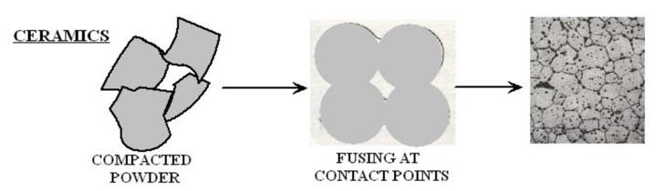
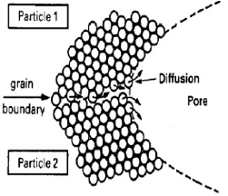
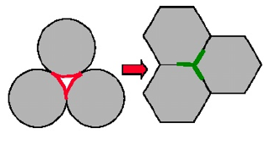
Ceramic sintering
Ceramics are typically sintered, and polycrystals also naturally form from sintering
In sintering, powders are compacted at high temperature
The particles are each oriented differently, and as they fuse, grain boundaries form
The differences between the grain orientations result in the grain boundary

Slide 19
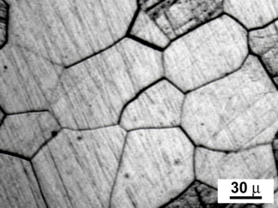
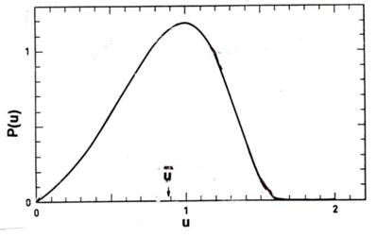
Distribution of grain sizes
In a polycrystal, there is also a distribution of grain sizes
Therefore, we commonly refer to the grain size distribution and the average grain size
The Hillert distribution is an analytical distribution for grain size
Real materials often vary from this behavior

Slide 20
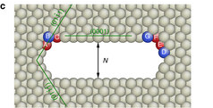
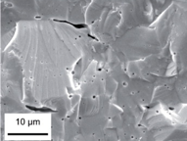
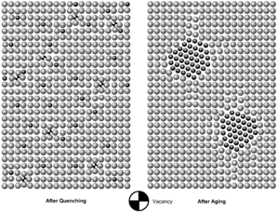
3D Defects
When point defects cluster, they form three dimensional defects
The energy of a point defects is reduced when several point defects cluster together
Larger clusters of vacancies are called voids
Clusters of impurity atoms are called precipitates

Slide 21
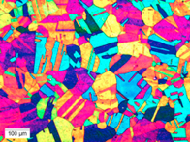
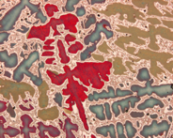
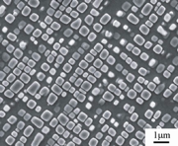
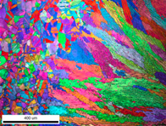
Microstructure
Material microstructure is the structure observable with 25x magnification
The microstructure includes grain structure, secondary phases, porosity, and more
The microstructure can strongly influence physical properties such as strength, toughness, ductility, hardness, corrosion resistance, high/low temperature behavior or wear resistance.
These properties in turn govern the application of these materials in industrial practice
Annealed Stainless Steel
Cast Bronze
Sintered UO2
Co-Al-W Superalloy
Friction stir welded stainless steel

Slide 22
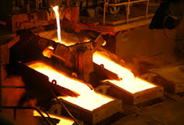
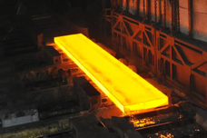
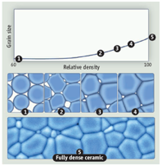
Material processing
The processes we use to make a material have a huge impact on its microstructure and properties
Casting – manufacturing process in which a liquid material is poured into a mold and then allowed to solidify
Can be used to make complex shapes
The solidified microstructure typically has properties that are far from ideal
Sintering – Forming a solid from a powder using heat and/or pressure without melting the material
Applicable to metals and ceramics
Difficult to obtain a material that is fully dense
Used to make fuel pellets
Heat treatment – heating or cooling a material to extreme temperatures to get desired microstructure and properties
Used to control the rate of microstructure change, including diffusion, grain growth, or phase change
Use on many types of materials (metals, ceramics, glasses)

Slide 23
Summary
Even during steady state operation, fuel and pellet conditions change with time due to microstructure evolution
Atoms in the fuel and cladding materials are arranged in a crystal lattice
The crystal lattice is never perfect; it has defects
Point defects include vacancies, interstitials, and impurity atoms
Dislocations are line defects
Grain boundaries are planar defects
Voids and precipitates are volume defects
All materials have defects, radiation damage causes many more defects
Microstructure can be tailored through processing

Slide 24
mechanistic modeling

Slide 25
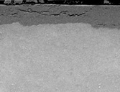
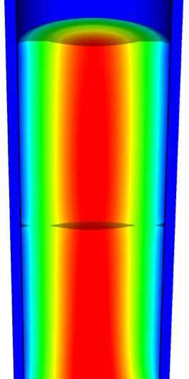
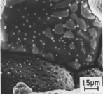
Microstructure-based fuel performance modeling
Structure/property relationships connect the microstructure variables to the property values
Operating Conditions
Neutron flux
Coolant T&P
Variables
Temperature
Displacement
Stoichiometry
Cladding
Property values
Microstructure evolution models
Microstructure evolution models
Fuel Property values
Elasticity tensor
Elasticity tensor
Grain growth
Grain growth
Cladding
Microstructure variables
Average grain size
Dislocation density
H concentration
Hydride fraction
Point defect concentrations
Loop density
2nd phase particle fraction
Fuel
Microstructure variables
Average grain size
Dislocation density
U defect concentrations
Pu concentration
Fission product precipitate fractions
Dissolved fission products
Fission gas bubble fraction
Grain boundary fission gas bubble coverage
Crack parameter
Plasticity
Plasticity
Thermal conductivity
Yield stress
Defect prod. & transport
Defect prod. & transport
Fracture stress
Thermal conductivity
Hydrogen transport
Fission gas behavior
Melting temperature
Failure criteria
Loop evolution
Densification
Diffusion constants
Dimensional change
Gap variable
Gap fission gas concentration
Fracture
Dimensional change

Slide 26


Example: fission gas behavior in the fuel
Take into account a finite set of variables to describe the state of the material
Utilize a mechanistic model of fission gas behavior to predict the evolution of the microstructure
Utilize this updated microstructure to inform a number of structure/property relationships
Variables
Temperature
Displacement
Stoichiometry
Elasticity tensor
Thermal conductivity
Model of fission gas behavior
Structure/property relationships
Fracture stress
Dissolved fission products
Fission gas bubble fraction
Grain boundary fission gas bubble coverage
Gap fission gas concentration
Dimensional change
Gap conductance
Gap pressure

Slide 27







Multiscale separate effects experiments and simulations inform the development of the models
nm
μm
mm

Slide 28


Microstructure-based models
Can provide a structure/property relationship to replace the existing burnup dependent model
For example, thermal conductivity, taking into account microstructural features and their evolution
Grain boundary and bubbles
Intragranular porosity
Precipitated fission products
κ_{pr}
Bulk conductivity
Vacancies and interstitials
Fission gas

Slide 29

Parametrizing the mechanistic model
We employ multiscale modeling and simulation to determine the various parameters for the model
MD simulations conducted at LANL have been used to determine the coefficients for various point defects
MD simulations have shown that phonon scattering must be accounted for to accurately represent small bubbles
Mesoscale simulations have shown that GrB bubbles have a larger impact on the thermal conductivity
Maxwell-Eucken (no phonon scattering)

Slide 30

Parametrizing the mechanistic model
A thermal resistor model is created to describe the impact of GrB bubbles on the thermal conductivity
MARMOT simulations are currently being used to inform the development of the precipitate multiplier

Slide 31
Parametrizing the mechanistic model
Each term in the expression must be coupled to a corresponding state variable
The full model calculates the thermal conductivity as a function of:
Temperature
Point defect concentrations
Intragranular bubble density and average radius
Fractional coverage of bubbles on GBs and average radius
Precipitate volume fractions and average sizes
Currently effects of precipitate fission products and individual point defects are neglected in the model, as they are not tracked or predicted in BISON

Slide 32
Comparing with experiments…
The model under-predicts the temperature in most cases, but not all
Thus, the model is neglecting some resistive effects from the microstructure
Generally performs as well, and in some cases better, than the burnup based model
RISO-3 AN3
RISO-3 AN4
RISO II-3
US PWR TSQ0002

Slide 33
UZr Fuel Performance Modeling
Development of a quantitative phase-field model of macroscale constituent redistribution in the U-Zr system, where model parameters were optimized, and the model validated against an independent data set
Calculation of surface tension based on molecular dynamics, which is used in the BISON gaseous metallic fuel swelling model

Slide 34

U3Si2 Fuel Performance Modeling
Point Defect Diffusion, Fission gas swelling, thermal and irradiation creep

Slide 35




TRISO Particle Fuel Performance Modeling
TRISO particle modeling is still under development from a mechanistic model standpoint
Imperfect data for many critical fission products through different layers
Data typically for UO2 only, not for UC or UCO fuel kernels

Slide 36



FeCrAl
Evolution of compositional randomness (precipitation) will affect the mechanical properties of FeCrAl
Kinetic Monte Carlo simulations modeled the precipitation of alpha’ phase from bcc Fe-Cr alloys under thermal aging at various temperatures
Fe-Al alloys do not show any phase separation
Can determine critical temperatures for precipitation and the resulting microstructures to investigate potential hardening

Slide 37
Summary
Researchers are working to develop materials models for the fuel and cladding that are mechanistic rather than empirical and that are based on the evolution of the microstructure rather than the burnup.

